Slide 1
CHAPTER 4.2:
The Addition Property of Inequalities
Algebra concepts

Slide 2
Objective
Students will solve inequalities using the addition property.

Slide 3
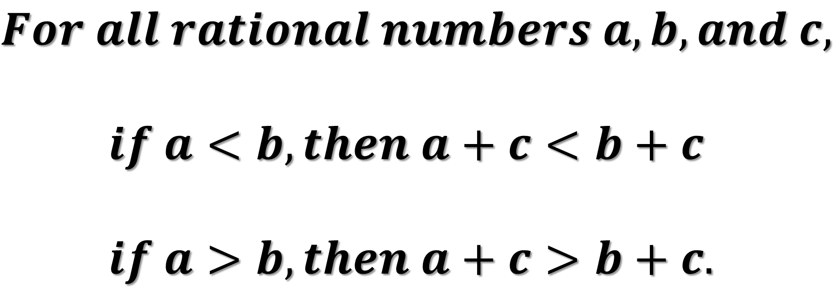
Addition Property of Inequalities
$$For all rational numbers a, b, and c,$$
    $if a<b, then a+c<b+c$
    $if a>b, then a+c>b+c.$

Slide 4
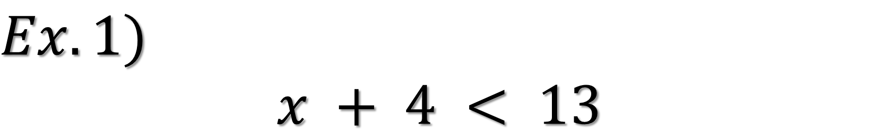
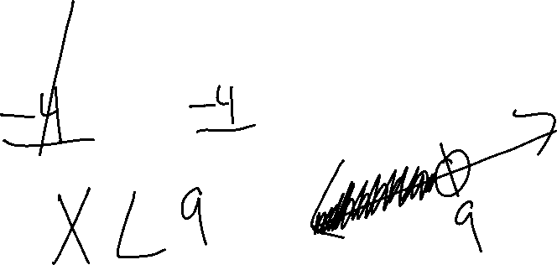
$$Ex.1)$$
$$x + 4 < 13$$

Slide 5
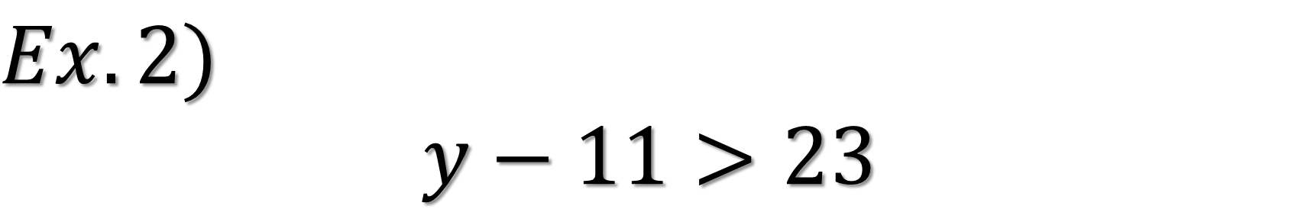
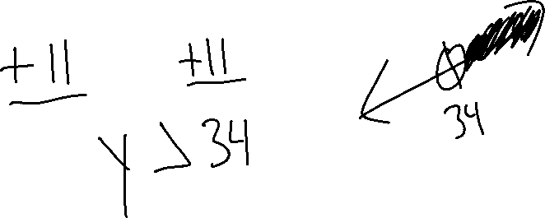
$$Ex.2)$$
$$y−11>23$$

Slide 6
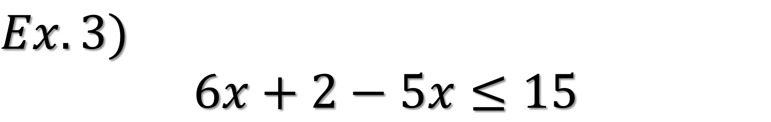
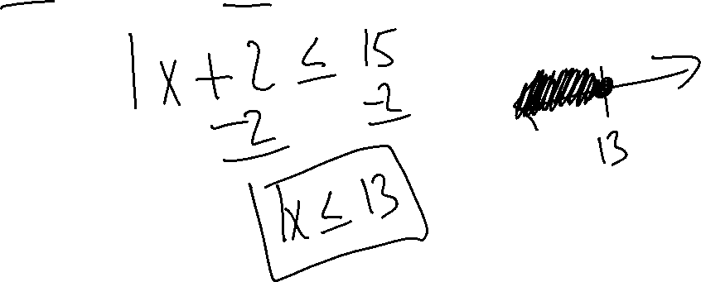
$$Ex.3)$$
$$6x+2−5x≤15$$

Slide 7
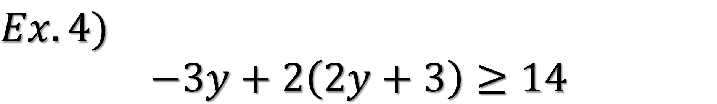
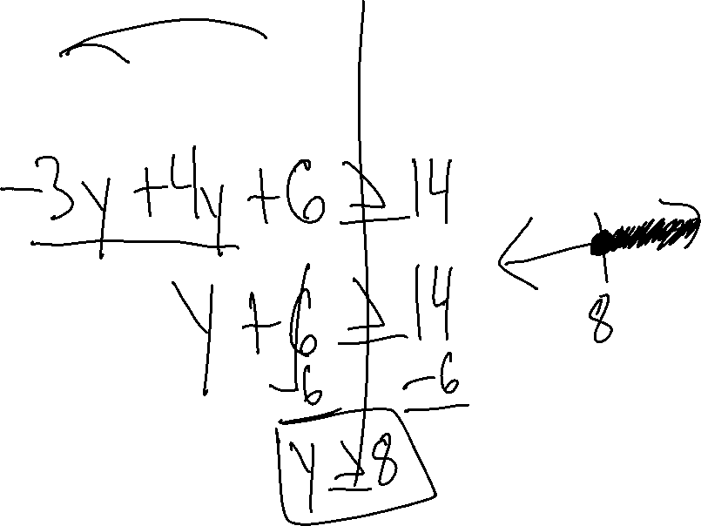
$$Ex.4)$$
$$−3y+2\left(2y+3\right)≥14$$

Slide 8
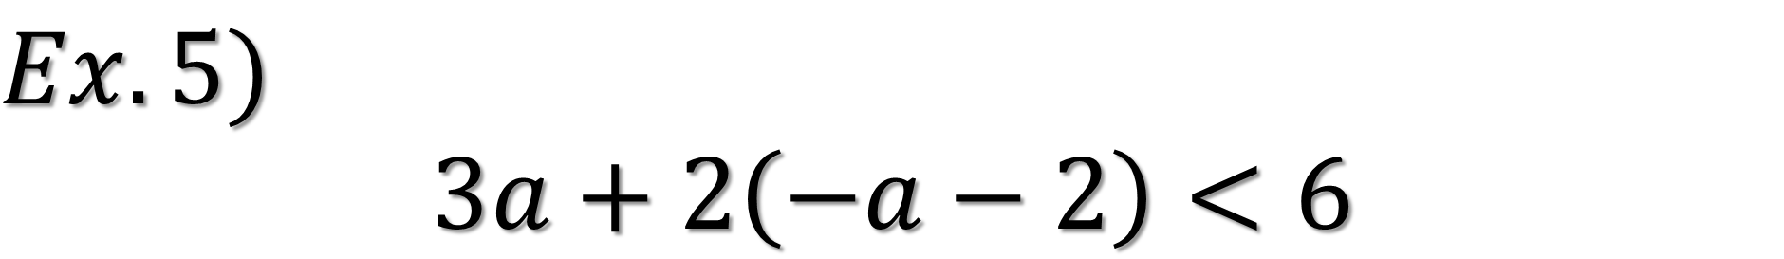
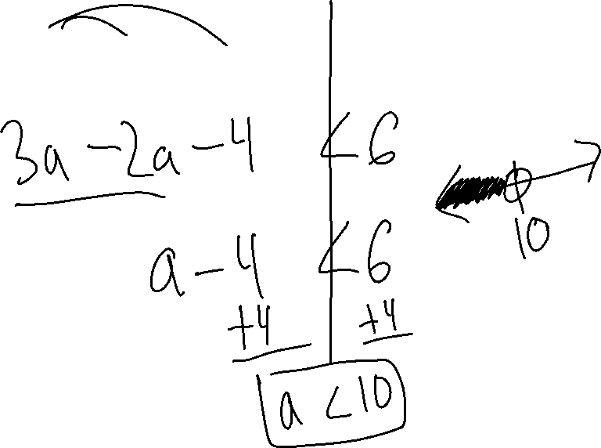
$$Ex.5)$$
$$3a+2\left(−a−2\right)<6$$

